Slide 1
Identifying Fraud Rings
Through Clustering Techniques
Ma. Charmagne Cruz
2026 Sep 24

Slide 2

Student Background
The Experiment
I lead Business Intelligence in Shopee PH. The company employs many fraud detection tools including existing ML models to identify various fraud types and fraudulent actors.
In 2025, our BI and Fraud Team deployed a clustering-based fraud-ring detection that automated a task previously consuming ~40% of agents' review time. The project cut that task from 7 hours to about 10 minutes (98% time savings).
This capstone doesn't test whether clustering can find fraud, that's already standard practice.
It tests whether a clustering result actually holds up once validated on data it hasn't seen, since the same technique that worked at Shopee could just as easily be a coincidence of that specific dataset.
The IEEE-CIS Fraud Detection dataset (Kaggle) serves as an independent, real-world testbed to find out.

Slide 3
Executive Summary
Business Context & Problem | Philippine business leaders reported estimated fraud losses of ₱4 trillion over the past year (TransUnion, 2025). It increasingly shows up as coordinated fraud rings, not lone bad actors. The IEEE-CIS dataset frames this exact tension: Vesta Corp's stated goal was to (1) catch more real fraud (true positives) while (2) reducing false declines (false positives) among legitimate customers. This is the same two-sided problem Shopee's fraud team lives with daily.
Objective | Group transactions into clusters by similarity alone, using K-Means, DBSCAN, and Hierarchical clustering. Never use the fraud label during clustering. Test afterward whether clusters concentrate real fraud above baseline, including on an 80/20 evaluation split (K-Means and DBSCAN only).
Main Results | The clustering results show encouraging fraud concentration, with important validation caveats. DBSCAN remained in the 8–10x baseline range on the evaluation split, while K-Means’s stronger in-sample result fell to roughly 3x baseline. This was a holdout-oriented robustness check, not fully leakage-free production validation.
Impact | Even a 1-point fraud-rate reduction can have meaningful revenue impact at financial institutions and ecommerce platforms due to their transaction volume.

Slide 4
Business Problem and Context |
Exec Summary gave the headline and now we can unpack it
Business Problem
A legitimate customer's card gets declined at checkout because a fraud model flagged it.
  Impact: friction in the process, lost sales, damaged trust.
A genuinely fraudulent transaction slips through
  Impact: direct cost to the platform.
Vesta's (and Shopee's) goal is both at once: increase true positives, decrease false positives. Optimizing only one makes the other worse.
Data Science Problem
The real bottleneck isn't one bad transaction, it's fraud rings: linked accounts working together.
This machine learning question: Can transactions be grouped into clusters that correspond to the same client, without using the fraud label to form the clusters?
  The dataset already had fraud labels, but they're used only for validation, not clustering; therefore testing whether the same method would work on future fraud rings with no labels to learn from yet.
  Because the dataset has no ground-truth client or fraud-ring identifier, this analysis measures fraud concentration. It does not prove that each cluster represents one underlying client.

Slide 5
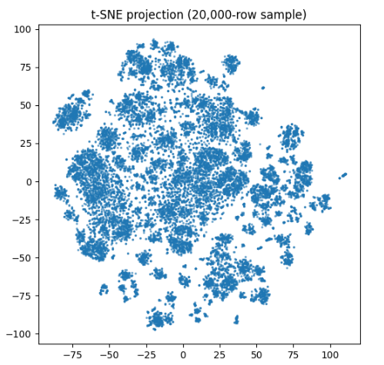
Data Source and Processed Results |From raw dataset to model-ready representation and Hopkins 0.981 suggested real cluster structure
Before/Raw:
~590K Vesta Corp transactions, 434 raw fields
~3.5% fraud rate (matching real-world incidence)
~76% missing identity/device data
Skewed, redundant, unscaled
After/Processed:
434 raw columns → 424 after sparse-column removal → 462 after feature engineering → 271 selected features → 102 PCA components
Missingness kept as a signal
  Two transactions both missing device data aren't actually similar, they're just both incomplete. Ignoring that gap would have created false matches.
Hopkins statistic: 0.981 on the initial sample; 0.970–0.982 across five random seeds, with a mean of 0.974.
  This is what told us the data had real patterns worth finding, not random noise, before we spent any time building a model.
  In short: the effort to cluster wasn't a gamble, it was justified upfront.
Each dot = one transaction.
The t-SNE visualization suggests local structure, but it is exploratory and does not by itself prove clusterability.
Notes:
Before building any model, we needed to check whether this data actually has structure worth clustering or if it's just noise. Each dot is one transaction, plotted so that similar transactions land near each other. What you see isn't one big blob or random scatter. It's distinct groupings. That's the visual version of the Hopkins statistic (0.981) mentioned earlier: real, exploitable structure existed in the data before we ever ran a clustering algorithm on it.

Slide 6
ML Solution and Implementation |Group transactions by similarity alone before checking which ones were fraud
Three different grouping methods were tested, since each catches a different kind of pattern:
  K-Means: sorts every transaction into a fixed number of neighborhoods.
  DBSCAN: finds naturally dense pockets of similar transactions and flags anything that doesn't fit anywhere as unusual.
  Hierarchical: builds a family tree of similarity, used as a sanity check on the other two.
The fraud label was excluded from the clustering fits. It was used afterwards for candidate-k selection and external validation.
K-Means and DBSCAN were evaluated using 80/20 splits. These were holdout-oriented robustness checks; shared preprocessing and DBSCAN’s eps were established earlier, and DBSCAN holdout labels were assigned using a KNN proxy.
Hierarchical clustering was evaluated on a smaller sample and was not holdout-tested.
590k Raw Transactions
Group by Similarity via 3 Methods (K-Means, DBSCAN, Hierarchical)
Check: Does any group have unusual fraud concentration?
Validate on data the model never saw (K-Means and DBSCAN)

Slide 7
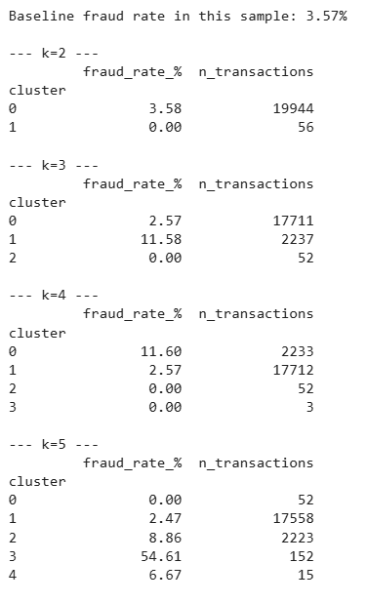
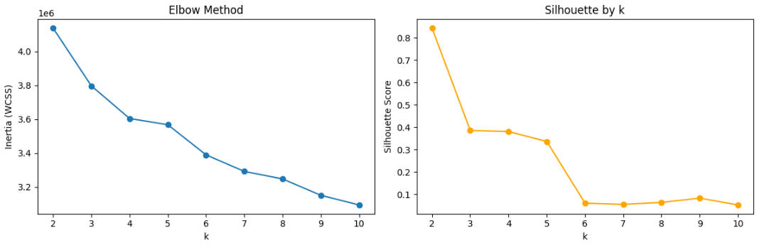
Results & Findings: K-Means | Fraud concentration, not Silhouette, decided k=5
Tested group sizes 2 to 10 on a 20,000-transaction sample.
Elbow and Silhouette pointed to different statistically reasonable values while fraud concentration determined k=5.
  Elbow pointed toward roughly k=3-4, Silhouette pointed to k=2.
  Both optimize for statistical shape, not fraud concentration
  Choosing k=3 or k=4 produced lower fraud concentration than k=5.
Chose 5 groups instead: one small, tight group of 152 transactions, 54.61% fraud — over 15x baseline.
Fraud labels were not used in the clustering fit, but they were used afterward to compare candidate k values against the business KPI. The final k=5 choice was post-hoc label-informed.

Slide 8
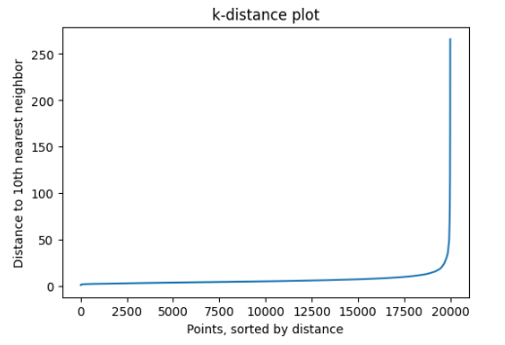
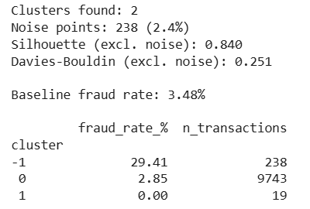
Results & Findings: DBSCAN |
The noise points held the real fraud signal
No fixed number of groups needed. It finds dense pockets and separately flags anything too sparse to belong anywhere, on a 10,000-transaction sample.
  Eps (the density threshold) was tuned on a 20,000-transaction sample; the model was then fit and evaluated on a 10,000-transaction subsample for speed.
Found 2 dense groups but the real finding was the leftover "doesn't fit anywhere" group:
  238 transactions, 29.41% fraud — over 8x baseline.
The two "normal" dense groups sat at or below baseline. The density-noise group contained the strongest fraud concentration in this sample.
Holdout caveat: DBSCAN has no native predict method, so holdout points were assigned using a KNN proxy. The result is encouraging but not production validation.
eps = 18.26 (knee point)

Slide 9
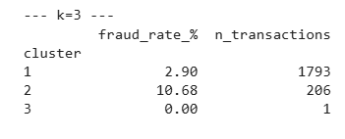
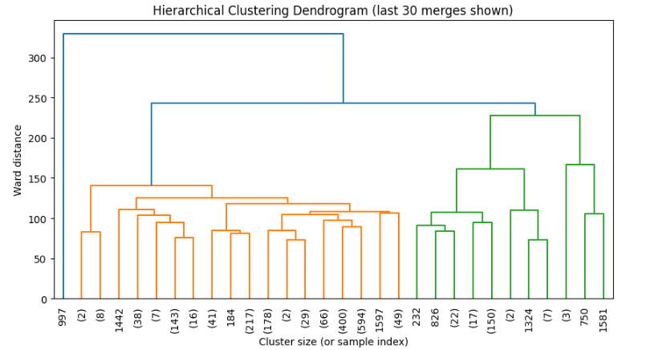
Results & Findings: Hierarchical | Smaller lift. Useful as a comparison.
Built a similarity tree on a smaller, 2,000-transaction sample
  This method doesn't scale like the other two because of computational cost.
The cleanest split isolated a meaningless outlier; finer splits fragmented into 1-3 transaction groups with wild, unreliable rates. These were small-sample noise, not signal.
Chose a 3-way split: a 206-transaction group, 10.68% fraud — 2.9x baseline.
  Smaller lift, but an observed pattern in this 2,000-transaction sample. It was not holdout-validated or stability-tested.
Not stress-tested on unseen data like the other two, due to its smaller sample size. It is the least proven of the three results and not necessarily the weakest.
k=3

Slide 10
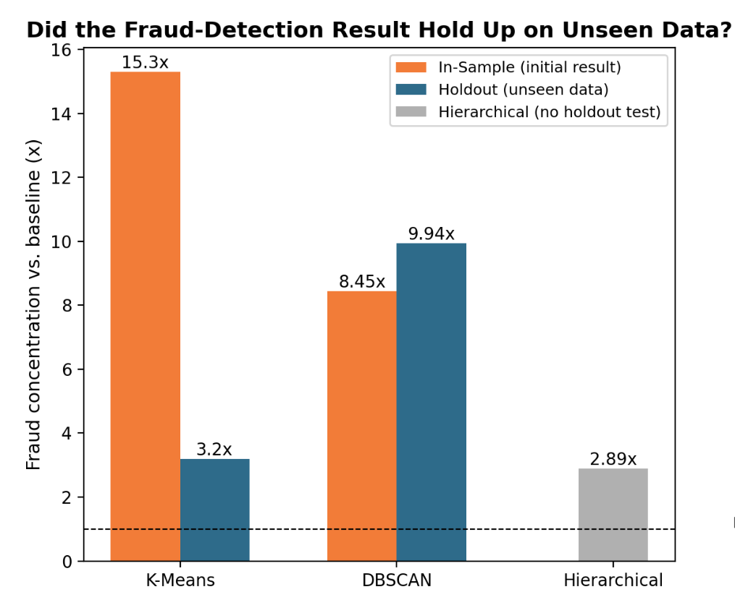
Interpretation | DBSCAN showed encouraging robustness; K-Means’s stronger in-sample result weakened on the evaluation split
All three methods found fraud-concentrated groups in their respective samples, supporting the exploratory premise of the project:
  K-Means 15.3x (54.61%)
  DBSCAN 8.45x (29.41%)
  Hierarchical 2.9x (10.68%)
Interpretation:
  DBSCAN remained in the 8–10x baseline range on the evaluation split. This was encouraging robustness evidence, but it used shared preprocessing, preselected eps, and a KNN assignment proxy.
  K-Means's 15x looked strongest at first, but dropped to roughly 3x on the evaluation split. A sample-specific fit, not a reliable pattern.
  Hierarchical's 2.9x was smaller and untested on unseen data. It is the least proven, not necessarily the weakest.
    Hierarchical provided a smaller-sample comparison, but was not holdout-validated and is not a deployment candidate.
Baseline (1x)

Slide 11
Business Impact and Implication |
Real savings but not production-ready yet
Revenue Impact | As noted, even a 1-point fraud-rate improvement is meaningful for companies like Vesta and Shopee. DBSCAN's 1-in-3 precision means less agent time burned on false alarms.
Operational Impact | Same logic as Shopee's own 2025 project (7 hrs to 10 mins): a validated fraud-concentrated cluster lets agents review a small, high-confidence pool instead of screening transactions one by one.
The Tradeoff | K-Means catches more fraud but floods agents with false alarms. DBSCAN is far more precise but misses most cases. A missed fraud ring costs the company directly, while a false decline costs a legitimate customer's trust. This means precision, and not just recall, determines what gets auto-actioned vs. escalated for review.
Bias Risk | Among the audited top 10 regions, region 330 had the highest actual fraud rate at 3.49% but was not flagged. Region 123 also had 0% flagged rate despite 2.97% actual fraud. Region 184 had 0% precision. These are screening signals using addr1 as a proxy, not proof of intentional discrimination.

Slide 12
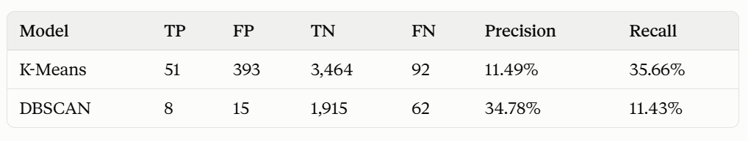
Conclusion & Recommendations |
Combine both models: K-Means as the net, DBSCAN as the filter
K-Means catches more fraud, but ~9 in 10 flags are false alarms. DBSCAN is more precise with 1 in 3 flagged as genuine fraud, but misses most cases.
To address Bias Risk:
  Set different flagging cutoffs per group instead of one rule for everyone
  Require human review on flags from groups that are usually wrong.
To address K-Means vs DBSCAN Tradeoff: Apply a two-step approach.
  Step 1: K-Means casts a wide, high-recall net to flag a candidate population
  Step 2: DBSCAN re-runs within that narrowed group as a precision pass, separating real fraud clusters from the false positives K-Means swept in
  This mirrors the Fraud Ops pattern: Cast wide, then refine to high-confidence cases before acting.
Bottom line: The two-stage funnel is designed to narrow the precision/recall gap. Recalibrating thresholds by subgroup is required to address the fairness gap. Neither should go live without the other.

